Slide 1
SECU 315 Project
John Curran

Slide 2
Background
The purpose of this project is to find out if there is any correlation between the number of hate crimes offenses from year to year and the amount of arrests made in hate crime cases and/or if there is any correlation to the amount of cases that the state clears each year
The project focuses on a 5 year stretch between 2012-2016 because during this stretch in time, we had the same Governor (Chris Christie), US Senators (Corey Booker and Rob Menendez), and POTUS (Barack Obama).
Notes:
Clearance- when someone is charged with a crime

Slide 3
Questions
Does the number of hate crimes and arrests made regarding hate crimes correlate?
Does the percentage of hate crime arrests correlate with the amount of offenses?
Does the number of hate crimes and cases cleared correlate with the amount of offenses that took place?
Does the number of hate crimes and percentage of cases cleared correlate with the amount of offenses that took place?
What is the most common type(s) of crimes committed in a hate related offense? (e.g. harassment, assault, etc.)
Did hate crimes increase in years there was a presidential election (2012 and 2016)?
Notes:
Clearance- when someone is charged with a crime

Slide 4

Data Source
https://www.njsp.org/ucr/crime-reports.shtml
I took Bias incident data from 2012-2016 provided from the New Jersey Attorney General’s office

Slide 5
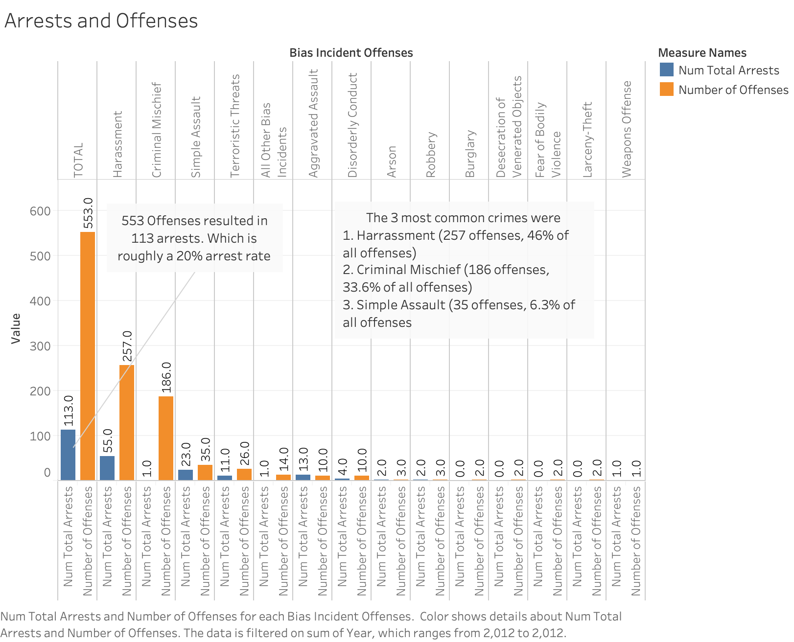
2012 Hate Crimes Arrests and Offenses

Slide 6
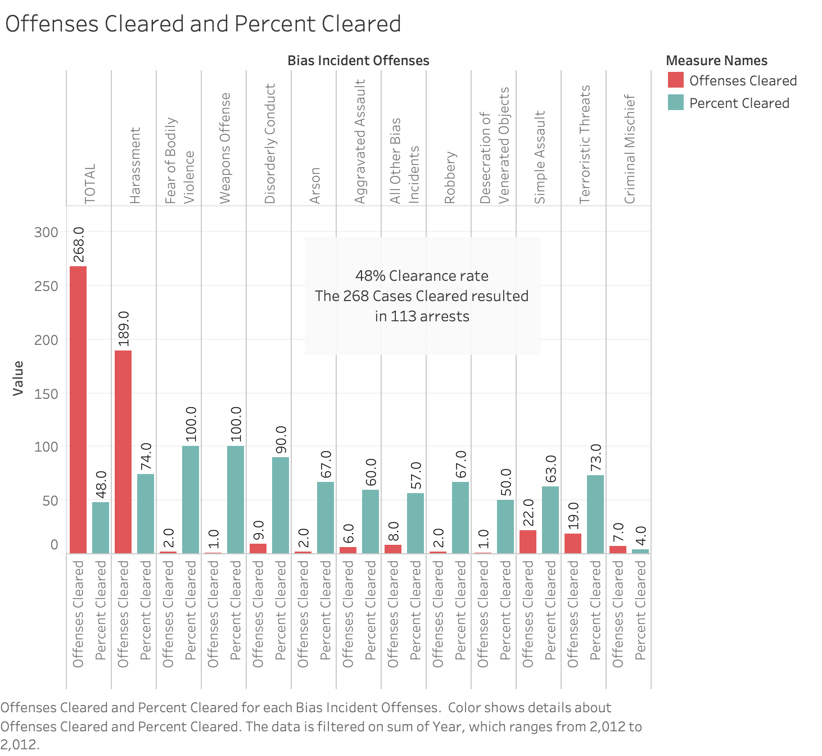
Offenses Cleared and Percent of Offenses Cleared in 2012
Notes:
553 total offenses resulted in 268 cases cleared

Slide 7
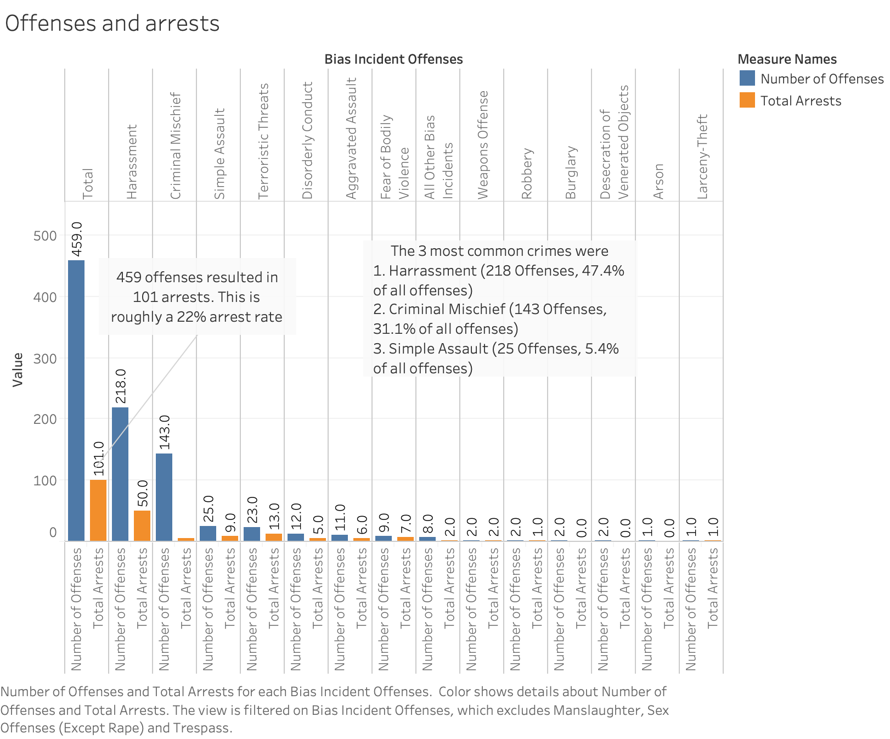
2013 Hate Crimes Arrests and Offenses

Slide 8
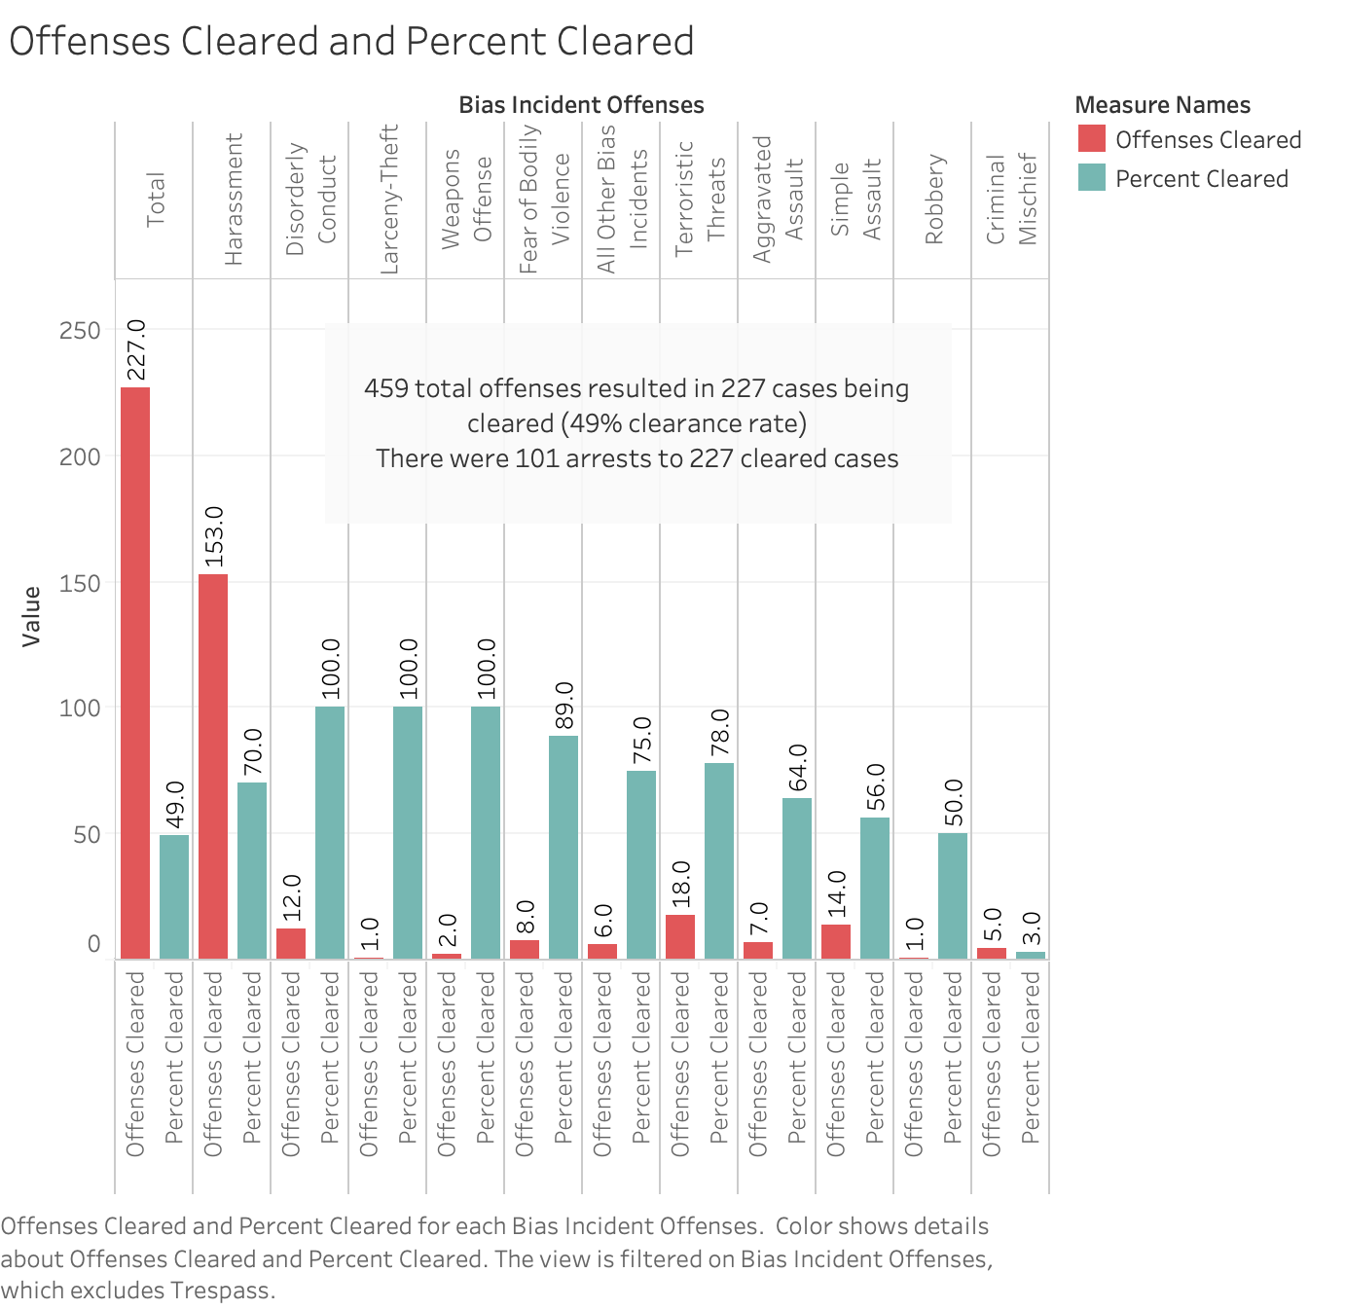
Offenses Cleared and Percent of Offenses Cleared in 2013

Slide 9
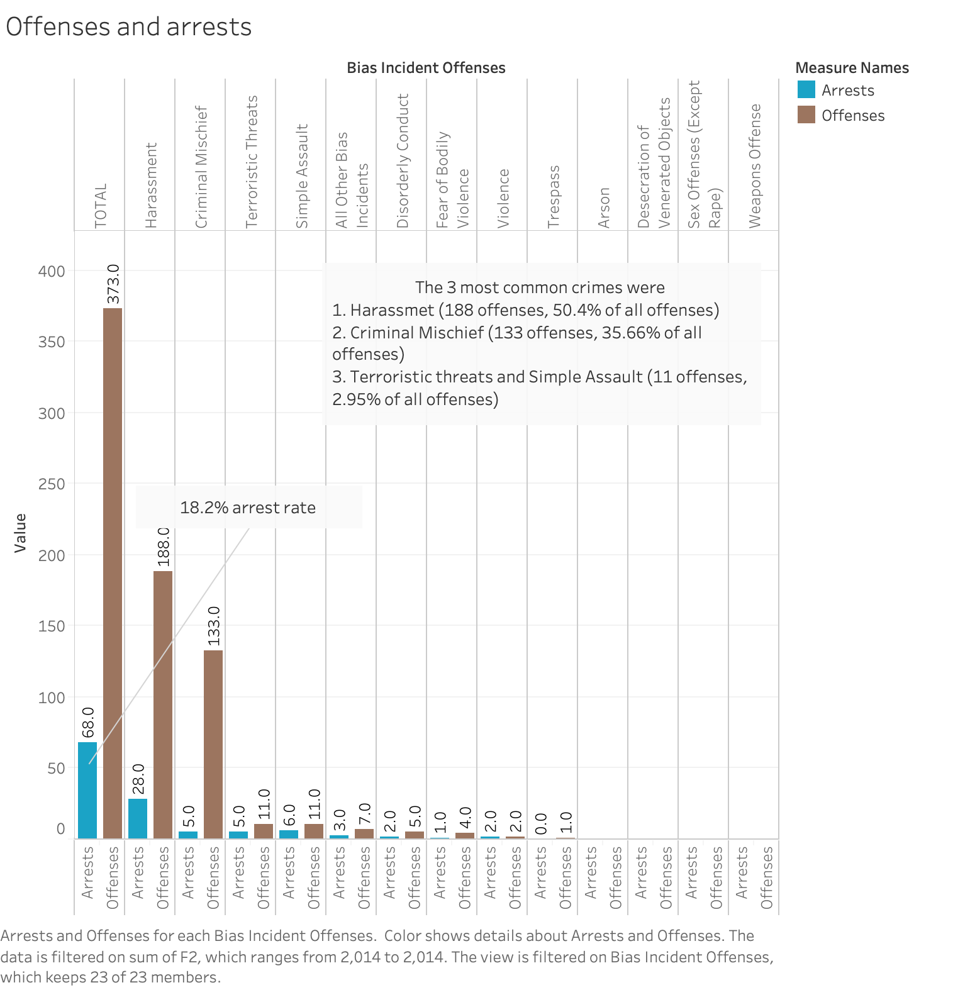
2014 Hate Crimes Arrests and Offenses

Slide 10
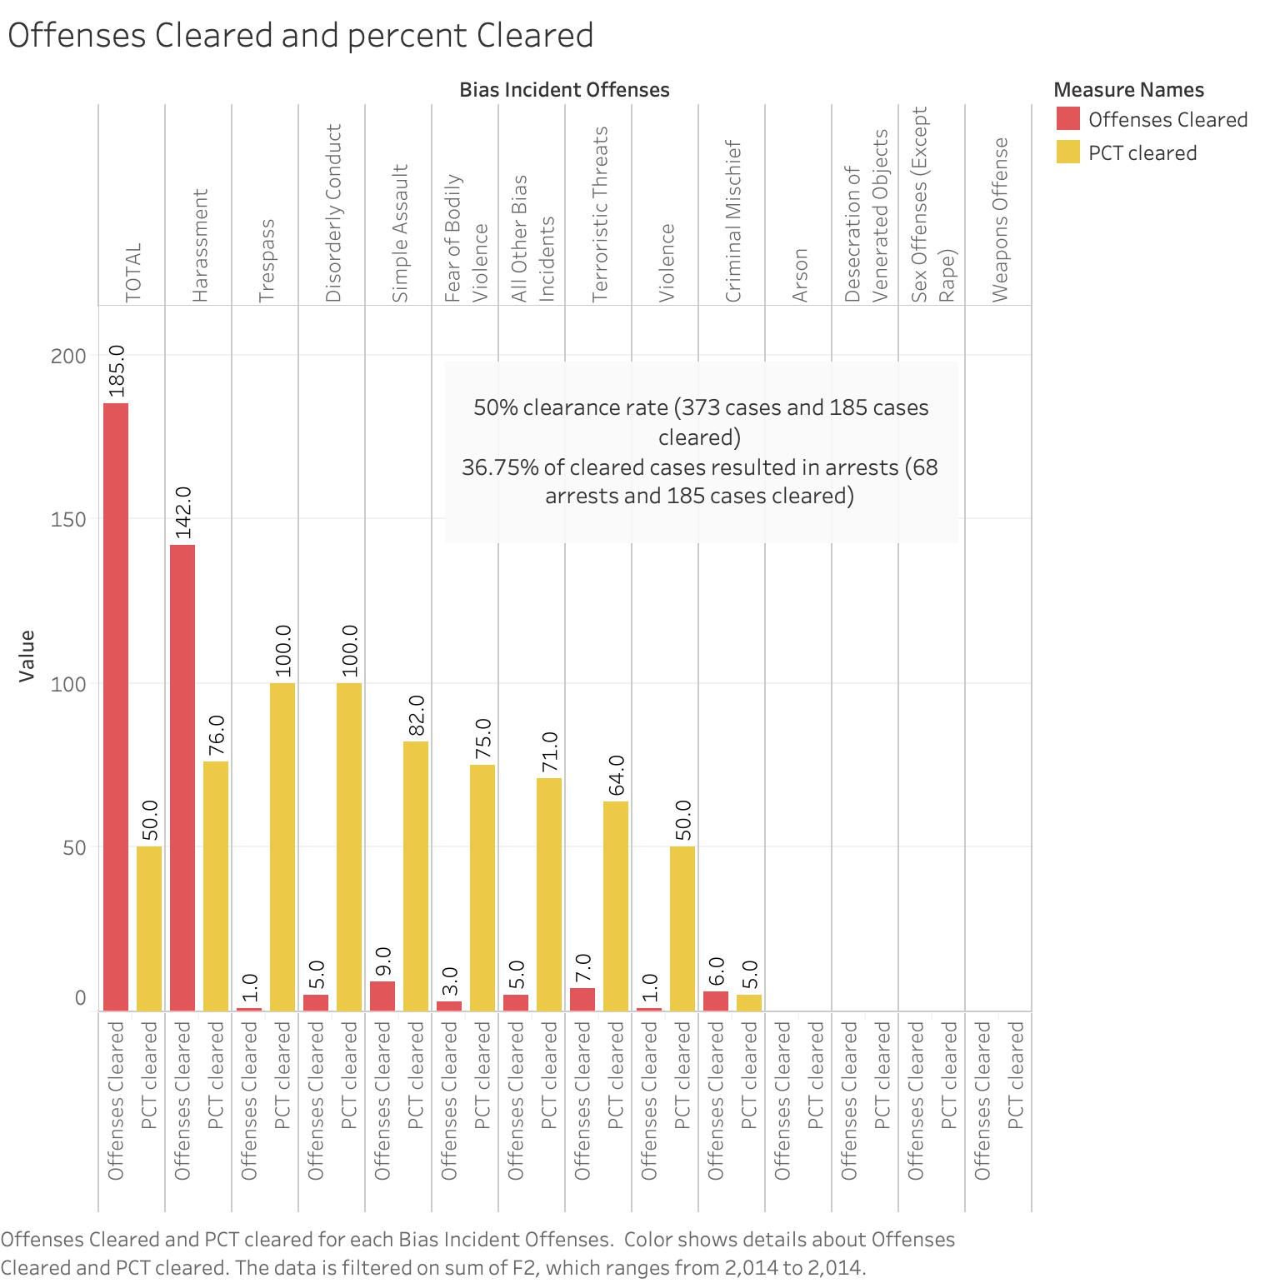
Offenses Cleared and Percent of Offenses Cleared in 2014

Slide 11
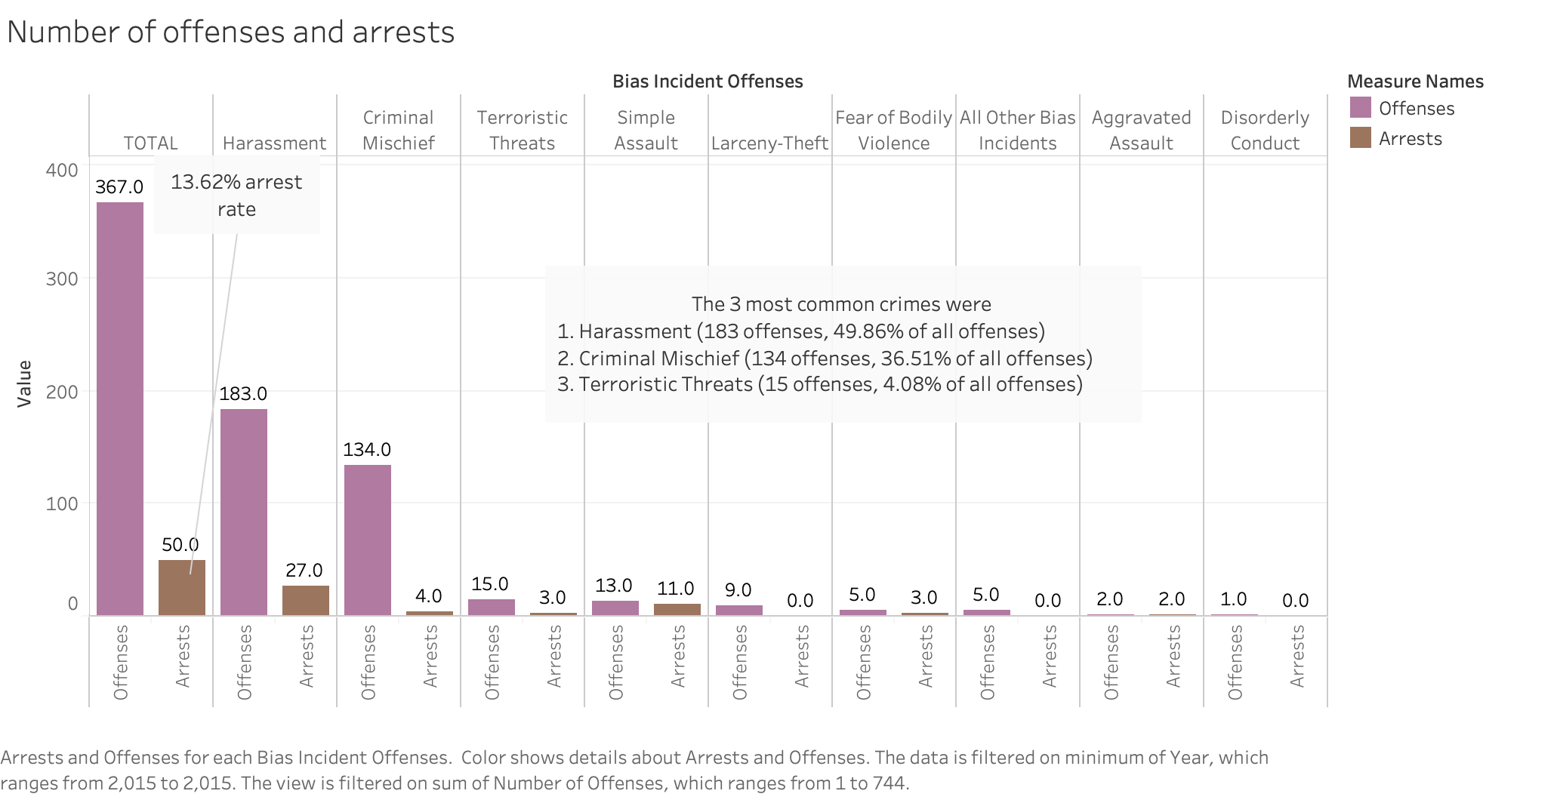
2015 Hate Crimes Arrests and Offenses

Slide 12
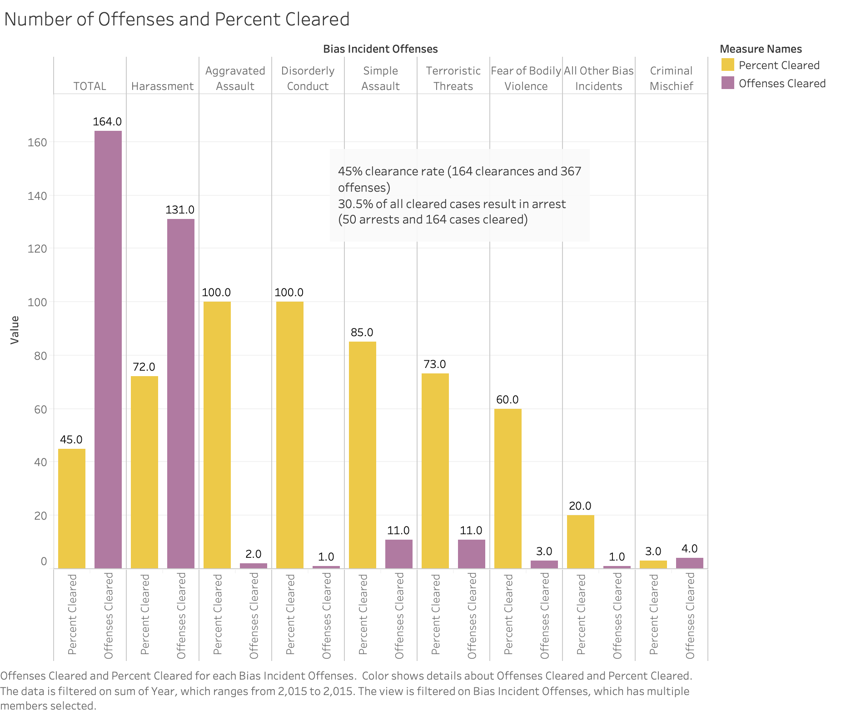
Offenses Cleared and Percent of Offenses Cleared in 2015

Slide 13
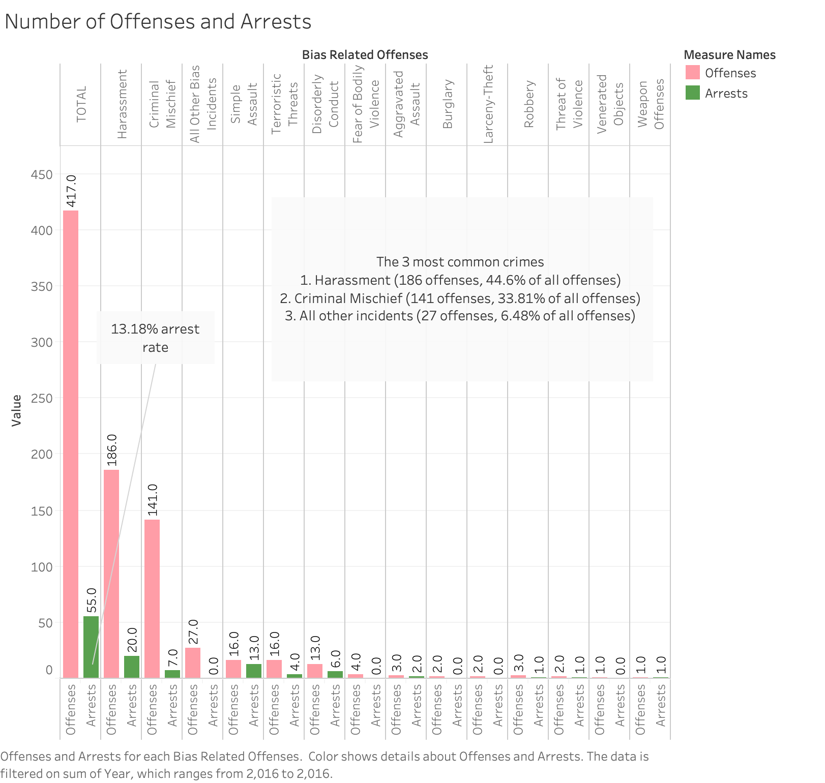
2016 Hate Crimes Arrests and Offenses

Slide 14
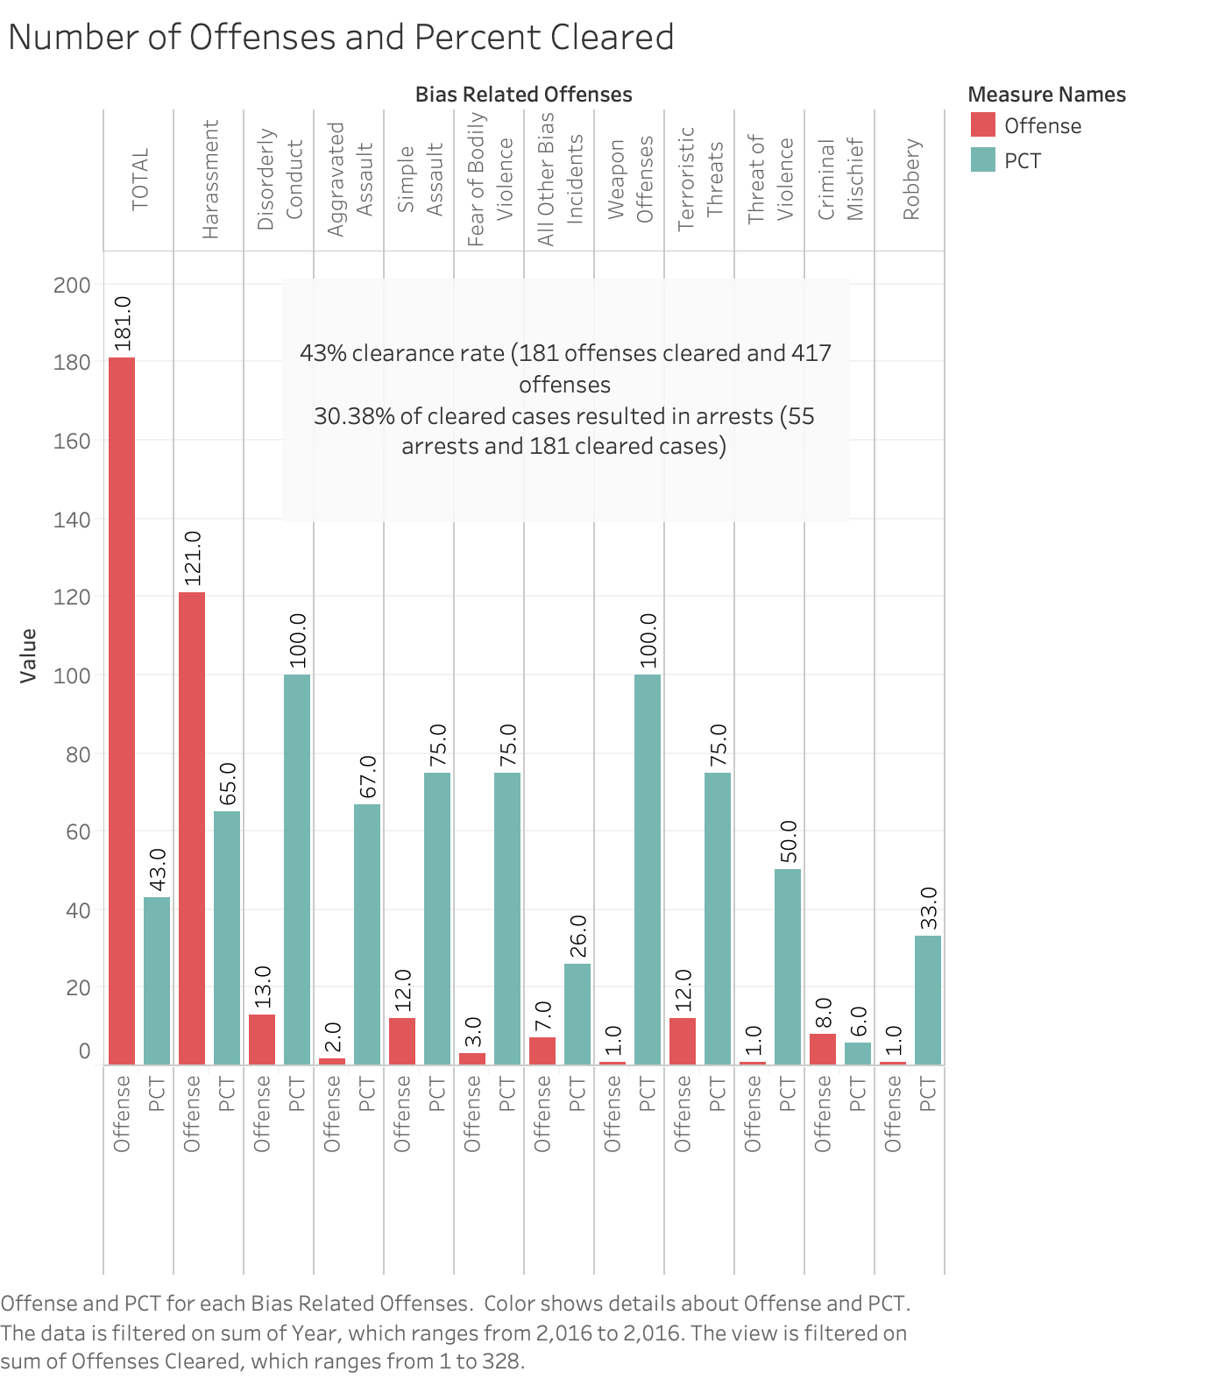
2016 Hate Crimes Offenses and Offenses Cleared

Slide 15
Conclusions
Offenses decrease from 2012-2015 and then increase in 2016.
2012 was the highest number of offenses (Presidential election year)
2016 saw an increase in 50 offenses from 2015 (2016 Presidential election year)
When the arrest rate is 20% or higher, there is a drastic decrease in offenses the next year. When the arrest rate drops under 15% the amount of offenses increases.

Slide 16
Conclusions Cont’d
When more than 100 arrests are made in a year, the amount of offenses the next year goes down significantly.
In all 5 years the clearance rate stayed relatively stagnant (between 43% and 50% annually)
When between 48% and 50% of cases are cleared, we see the number of offenses decrease
The most common crime we see from year to year is Harassment

Slide 17
Next steps
This research should be expanded to observe if these numbers correlate on a National Level and over a more extended period of time.
Further Research should look at the trend in hate crimes during the same year as a Presidential Election

